Slide 1
Access Control
Chester Rebeiro
Indian Institute of Technology Madras

Slide 2
Access Control (the tao of achieving confidentiality and integrity)
Who can access What
Objects :
Files/ Programs/ Sockets/
Hardware/
Subjects :
User/ process/ application
Read/Write/
Execute/Share

Slide 3
Access Control (number of levels)
Elaborate and complex. Many people may be involved
Multiple roles. Hundreds of transactions feasible
Application
Eg. DBMS. Who gets to access what fields in the DB
Middleware
OS
Moving from Hardware to Application
More aspects to control
More subjects and objects involved
Inter-relationship becomes increasingly difficult
Complexity increases
Reliability Decreases
More prone to loopholes that can be exploited
Hardware

Slide 4
Hardware Access Control
Policies
Must protect OS from applications
Must protect applications from others
Must prevent one application hogging the system
(first two ensure confidentiality and integrity, the third ensures availability)
Mechanisms
Paging unit
Privilege rings
Interrupts
Notes:
Other policy :
NX bit : prevent execute from stack
Code segment is made read-only

Slide 5
Access Control at OS Level
Policies
Only authenticated users should be able to use the system
One user’s files should be protected from other users (not present in older versions of Windows)
A Process should be protected from others
Fair allocation of resources (CPU, disk, RAM, network) without starvation
Mechanisms
User authentication
Access Control Mechanisms for Files (and other objects)
For process protection leverage hardware features (paging etc.)
Scheduling, deadlock detection / prevention to prevent starvation

Slide 6
Access Control for Objects in the OS
Discretionary (DAC)
Access based on
Identity of requestor
Access rules state what requestors are (or are not) allowed to do
Privileges granted or revoked by an administrator
Users can pass on their privileges to other users
The earliest form called Access Matrix Model

Slide 7
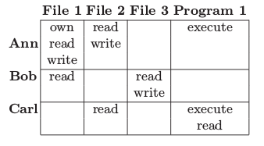
Access Matrix Model
By Butler Lampson, 1971 (Earliest Form)
Subjects : active elements requesting information
Objects : passive elements storing information
Subjects can also be objects
objects
subjects
rights
Other actions : ownership (property of objects by a subject),
control (father-children relationships between processes)
Butler Lampson, “Protection”, 1971

Slide 8




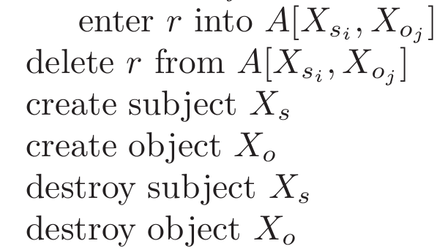
A Formal Representation of Access Matrix
Define an access matrix :
Protection System consists of
Generic rights : thus
Primitive Operations
objects
subjects
generic rights
Michael A. Harrison, Walter L. Ruzzo, Jeffrey D. Ullman, Protection in Operating Systems, 1974

Slide 9
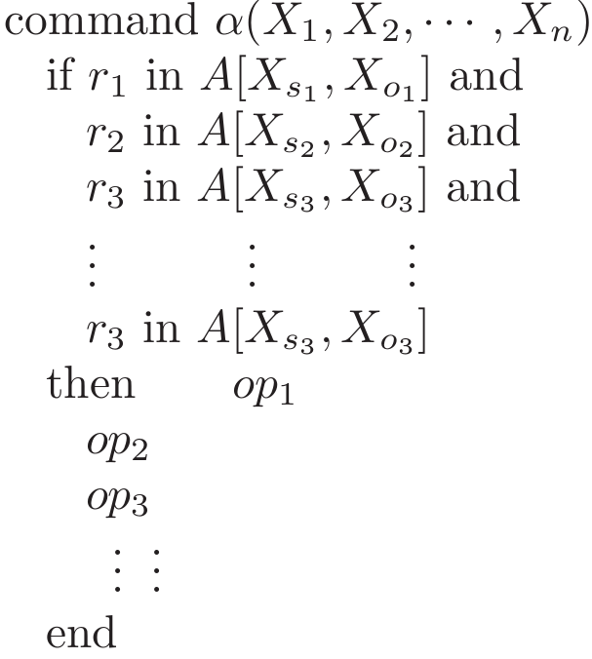
A formal representation of Access Matrix Model
Commands : conditional changes to ACM
access matrix
Generic rights
Primitive
operations

Slide 10


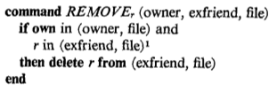
Example Commands
Create an object
Confer ‘r’ right
to a friend for the
object
Owner can revoke
Right from an ‘ex’friend

Slide 11
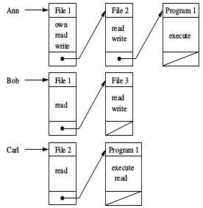
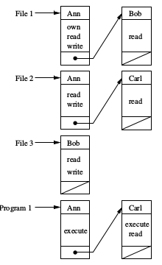
Implementation Aspects
Capabilities
Access Control List
Capabilities : ticket
ACL : My name is in the list
Railway Reservation
Notes:
Authorization Tables:
Matrices can get too big….. Sometimes roles (eg. TA, Faculty, student) will be preferred
Also, instead of a matrix → a table can be used
ACL : Advantages : Suited when users can change their permissions for a file; also useful for centrally controlled policy
Disadvantages : Becomes difficult to manage for large user population that is constantly changing, not suited when users want to delegate their work to another
Difficult to find all files of a user, since it is distributed
Capabilities:
Easy to delegate responsibility.
For example “Ann” can create a certificate stating that she delegates to “Ted” all her activities from 4:00PM to 10:00PM

Slide 12
Capability vs ACL
Delegation
CAP: easily achieved
For example “Ann” can create a certificate stating that she delegates to “Ted” all her
activities from 4:00PM to 10:00PM
ACL: The owner of the file should add permissions to ensure delegation
Revocation
ACL: Easily done, parse list for file, remove user / group from list
CAP: Get capability back from process If one capability is used for multiple files, then revoke all or nothing

Slide 13
Unix Security Mechanisms
Chester Rebeiro
Indian Institute of Technology Madras

Slide 14
Unix Security Mechanism
Subject:
Users and groups
special subject for the `root’ of the system
processes that a user creates will have all your rights
Objects: files, directories, sockets, process, process memory, file descriptors. The root owns a set of objects
A typical DAC configuration.
Default rights given to users
Users can transfer rights

Slide 15
Unix Login Process
Login process
Started at boot time (runs as ‘root’)
Takes username and password
Applies crypt() to password with stored salt
Compares to value in /etc/shadow for that user
Starts process for user
Executes file specified as login in /etc/passwd
Identity (uid, gid, groups) is set by login

Slide 16
User IDs
Each user represented by a user ID and group ID
UID = 0 is root permissions
setuid(user ID) →set the user id of a process. Can be executed only by processes with UID = 0
Allows a program to execute with the privileges of the owner of the file.
setgid(group iD) → set the group id of a process
Notes:
User id to user name mapping stored in /etc/passwd
/etc/shadow contains a hash of the password
/etc/group contains all the groups this user is peresent in
Example of passwd file which changes the password
Any one can change their password
However, passwords are stored in /etc/shadow, which is owned by root.
So, how does this work?
Passwd have their setuid bit enabled.
Thus, when run as from a regular user, the user would temporarlly run as root
r

Slide 17
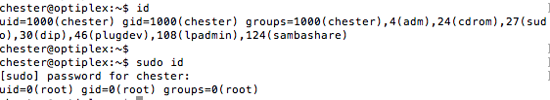
sudo / su
used to elevate privileges
If permitted, switches uid of a process to 0 temporarily
Remove variables that control dynamic linking
Ensure that timestamp directories (/var/lib/sudo) are only writeable by root

Slide 18

Points to Ponder
passwd is a command by which a user can change his/her password. Thus runs with user’s uid
All passwords are stored in encrypted form in /etc/shadow and thus is owned by the root.
Thus passwd will modify the shadow file
How can a user process modify a file owned by the root

Slide 19
File Operations in Unix
Operations for a file
Create
Read
Write
Execute (does this imply read?)
Ownership (chown)
Change permissions
Change group (chgrp)
Operations for a directory
Create
Unlink / link
Rename a file
lookup
Permissions for files and directories
In inode : uid, gid
Change permissions by owner (same uid as the file)
For directories almost similar: linking / unlinking write permissions
X permission on a directory implies look up. You can look up a name but not read the contents of the directory
Additionally bits are present to specify type of file (like directory, symbolic link, etc.)
 | R | W | X
Owner | 1 | 1 | 0
Group | 1 | 0 | 0
Other | 1 | 0 | 0
Notes:
Execute means that user cannot read the file or make a copy
But the OS can read the file for special purposes
open(“/etc/passwd”, ..)
The OS will do the following checks
X permissions on /
X permissions on /etc
R permissions on /etc/passwd
Groups for Students of SSE
Groups for Tas in IITM
How would you create a file that is readable only by the Tas of SSE.

Slide 20
File Descriptors
Represents an open file
Two ways of obtaining a file descriptor
Open a file
Get it from another process
for example a parent process
Through shared memory or sockets
Security rests in obtaining a file descriptor
If you have a file descriptor, no more explicit checks

Slide 21
Processes
Operations
Create
kill
Debug (ptrace system call that allows one process to observe the control the other)
Permissions
Child process gets the same uid and gid as the parent
ptrace can debug other processes with the same uid

Slide 22
Network Permissions in Unix
Operations
Connect
Listening
Send/Receive data
Permissions
Not related to UIDs. Any one can connect to a machine
Any process can listen to ports > 1024
If you have a descriptor for a socket, then you can send/receive data without further permissions

Slide 23
Problems with the Unix Access Control
Root can do anything (has complete access)
Can delete / modify files (FreeBSD, OSX, prevent this by having flags called append-only, undeletable, system → preventing even the root to delete)
Problem comes when (a) the system administrator is untrustable (b) if root login is compromised
Permissions based on uid are coarse-grained
a user cannot easily defend himself against allegations
Cannot obtain more intricate access control such as “X user can run program Y to write to file Z”
Only one user and one group can be specified for a file.

Slide 24
Information Flow Policies
Chester Rebeiro
Indian Institute of Technology Madras

Slide 25

Drawback of Discretionary Policies
It is not concerned with information flow
Anyone with access can propagate information
Information flow policies
Restrict how information flows between subjects and objects
read
copy
Notes:
Anyone with access can propagate information
-→ for example….
Bob c

Slide 26
Trojan Horses
Discretionary policies only authenticate a user
Once authenticated, the user can do anything
Subjected to Trojan Horse attacks
A Trojan horse can inherit all the user’s privileges
Why?
A trojan horse process started by a user sends requests to OS on the user’s behalf

Slide 27
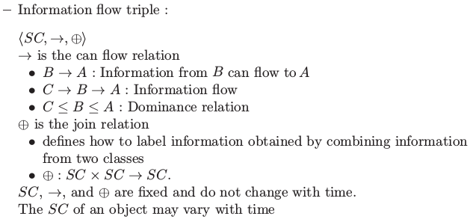
Information Flow Policies
Every object in the system assigned to a security class (SC)
high
A
Security classes (SC)
B
Information flow
C
object
low
Ravi Sandhu, Lattice Based Access Control Models, 1993

Slide 28


Examples
Trivial case (also the most secure)
No information flow between classes
Low to High flows only
Notes:
Note that A_1 + A_2 \ne A_2.
… why cannot this be A_1
…. If it is A_1, then there is flow of information from A_2 → A_1, which violates the second condition

Slide 29
Ponder About
A company has the following security policy
A document made by a manager can be read by other managers but no workers
A document made by a worker can be read by other workers but no managers
Public documents can be read by both Managers and Workers
What are the security classes?
What is the flow operator?
What is the join operator?
Notes:
Sec classes {P, W, M}
P→M, P→W, M→M, W→W
P+M→M, P+W→W, M+M→M, W+W→W

Slide 30
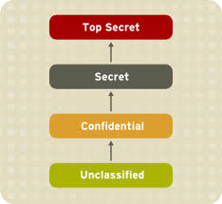
Mandatory Access Control
Most common form is multilevel security (MLS) policy
Access Class
Objects need a classification level
Subjects needed a clearance level
A subject with X clearance can
access all objects in X and below X
but not vice-versa
Information only flows upwards and
cannot flow downwards
Notes:
Basis for categorizations
… based on number of lives …
…. Large number of lives endangered (Top Secret)
… lesser number of lives endangered (Secret)

Slide 31
Bell-LaPadula Model
Developed in 1974
Objective : Ensure that information does not flow to those not cleared for that level
Formal model for access control
allows formally prove security
Four access modes:
read, write, append, execute
Three properties (MAC rules)
No read up (simple security property (ss-property))
No write down (*-property)
ds property : discretionary security property (every access must be allowed by the access matrix)
D. E. Bell and L. J. LaPadula, Secure Computer System: Unified
Notes:
MAC – mandatory access control

Slide 32

No read up
Clearance : Confidential
Can only read confidential and unclassified files

Slide 33
No Write Down
Clearance : Confidential
Cannot write into an unclassfied object

Slide 34
Why No Write Down?
Process with
confidential clearance
trojan
Read higher classified object
Write to a lower level
A process inflected with a trojan, could read confidential data and write it down to unclassified
We trust users but not subjects (like programs and processes)

Slide 35
ds-property
Discretionary Access Control
An individual may grant access to a document he/she owns to another individual.
However the MAC rules must be met
MAC rules over rides any discretionary access control. A user cannot give away data to unauthorized persons.

Slide 36
Limitations of BLP
Write up is possible with BLP
Does not address Integrity Issues
file with classification secret
Clearance : Confidential
User with clearance can modify a secret document
BLP only deals with confidentiality. Does not take care of integrity.

Slide 37
Limitation of BLP (changing levels)
Suppose someone changes an object labeled top secret to unclassified.
breach of confidentiality
Will BLP detect this breach?
Suppose someone moves from clearance level top secret to unclassified
Will BLP detect this breach?
Need an additional rule about changing levels
Notes:
No: BLP is only concerned with subjects accessing objects. Does not concern with a file that changes level

Slide 38
Tranquility
Strong Tranquility Property:
Subjects and objects do not change label during lifetime of the system
Weak Tranquility Property:
Subjects and objects do not change label in a way that violates the spirit of the security policy.
Should define
How can subjects change clearance level?
How can objects change levels?

Slide 39
Limitations of BLP (Covert Channels)
Process with
confidential clearance
trojan
Read higher classified object
Communication
through covert channel
Covert channels through system resources that normally not intended for communication.
covert channel examples: page faults, file lock, cache memory, branch predictors , rate of computing, sockets
Highly noisy, but can use coding theory to encode / decode information through noisy channels

Slide 40
Biba Model
Bell-LaPadula upside down
Ignores confidentiality and only deals with integrity
Goals of integrity
Prevent unauthorized users from making modifications to an object
Prevent authorized users from making improper modifications to an object
Maintain consistency (data reflects the real world)
Incorporated in FreeBSD

Slide 41

BIBA Properties (read up / write down)
High integrity
read
write
write
read
Low integrity
Properties
No read down : Simple Integrity Theorem
No write up : * Integrity Theorem
Kenneth J. Biba in 1975

Slide 42
Why no Read Down?
High integrity
Low integrity
A higher integrity object may be modified based on a lower integrity document

Slide 43


Example
Read Up
A document from the general should be read by all
No Read Down
A private’s document should not affect the General’s decisions
General
Captains
Privates

